Slide 1

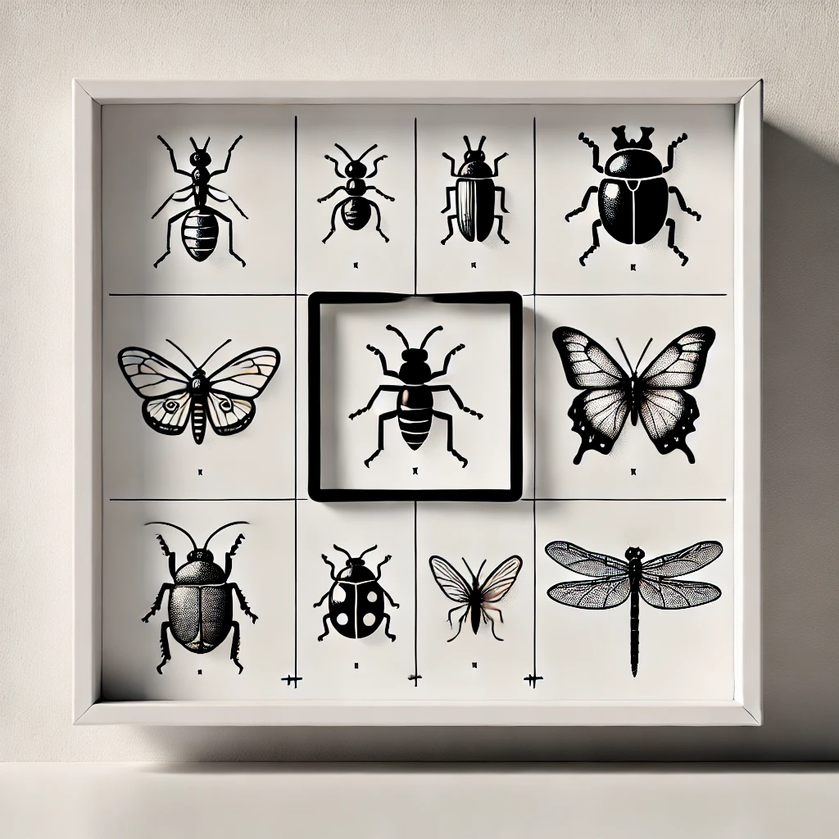
A Comparison of Convolutional Neural Network Architectures for Insect Detection of Different Sizes
Saghar Ghaffari
FH Kärnten, Austria
FH-PROF.DR.-ING.KARL-HEINRICH ANDERS
FH-PROF IN DIPL-ING. DR.NTECHN. ADRIJANA CAR

Slide 2
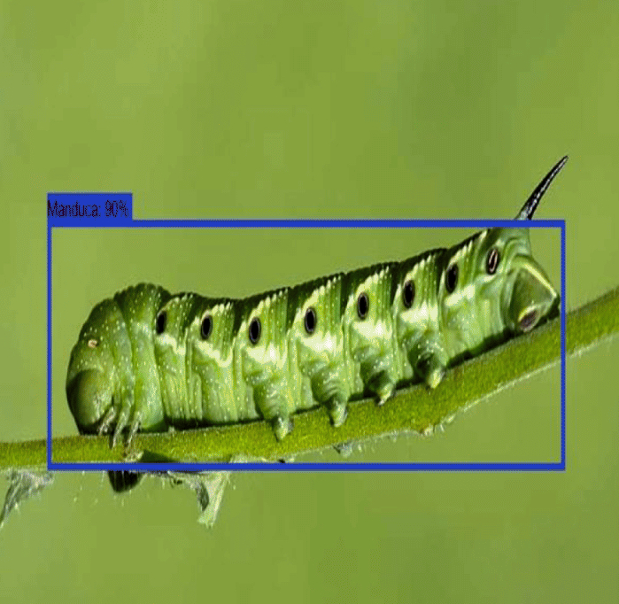
TABLE OF CONTENTS
Motivation
Research Questions
Methodologies
Evaluation Metrics
Results
Insights

Slide 3
TABLE OF CONTENTS
Motivation
Research Questions
Methodologies
Evaluation Metrics
Results
Insights

Slide 4
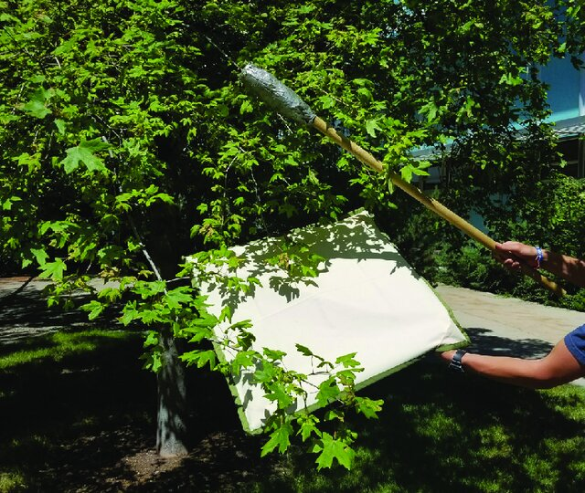
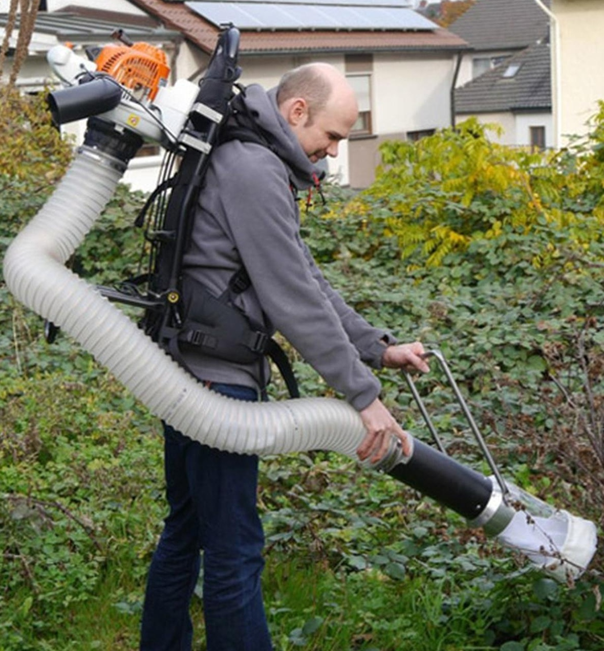
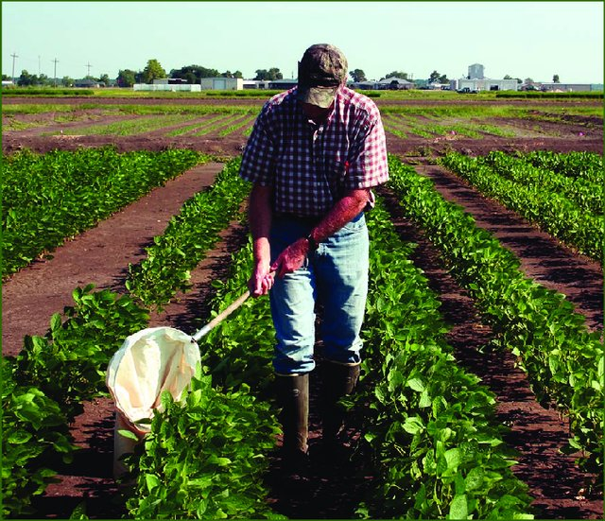
Motivation
Traditional Methods in Insect Monitoring
Direct Observation
Trapping Techniques
Sampling Methods
Traditional Methods Limitations
Invasive
labour-intensive
prone to human error.
Limited scalability for large-scale monitoring
Difficulty in detecting smaller or hidden insects in complex environments.

Slide 5
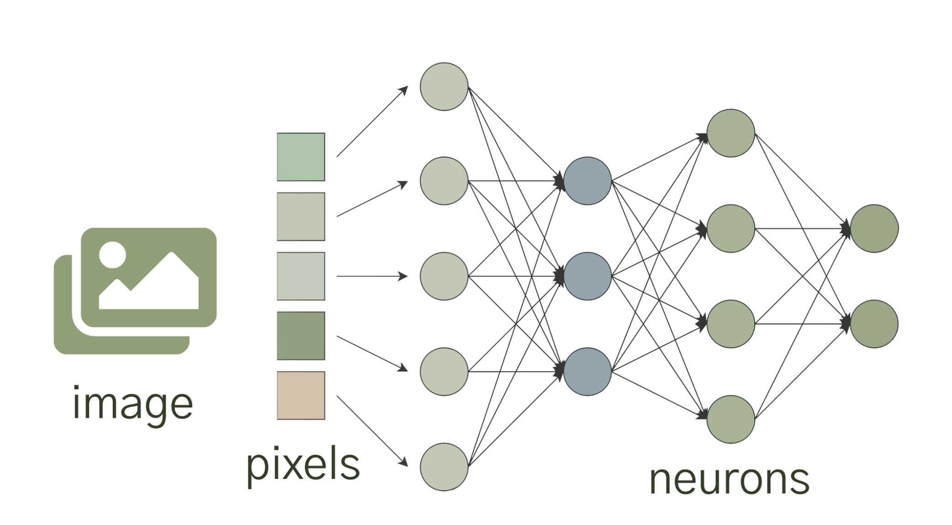
Motivation
Integration of Machine Learning
Unmanned Aerial Systems
Automated Image Analysis
Contemporary Methods in Insect Monitoring
Advantages of leveraging Machine Learning
Automated image analysis:
Reduces manual effort by automatically detecting and classifying insects.
Accuracy:
excels at high-precision detection, even for small insects in cluttered environments
Scalability:
Suitable for large-scale, real-time monitoring in diverse environments.
Non-invasive:
Does not harm or disrupt insect habitats.
Notes:
The integration of ML techniques, including CNNs and Deep Learning (DL) mod- els, has been transformative in insect monitoring. These methods automate the processes of detection, classification, and counting of insects from imagery, signifi- cantly improving both efficiency and accuracy. ML models are trained on labeled datasets to recognize patterns and features associated with different insect species. However, these methods face challenges such as the need for high-quality training data, the risk of overfitting, and substantial computational demands (Valan et al. 2019). Furthermore, maintaining model performance over time requires regular updates and retraining, especially in dynamic environments where insect popula- tions and habitats may change (Kumar et al. 2023).
Traditional methods of insect monitoring, such as direct observation, trapping, and sampling, remain valuable but are increasingly supplemented by these advanced technologies. The shift towards automated, scalable, and less invasive methods reflects broader trends in ecological monitoring, aiming to improve accuracy and reduce the environmental impact of data collection. As these technologies continue to evolve, they offer promising opportunities for more effective and efficient insect monitoring (Valan et al. 2019), (Kumar et al. 2023).

Slide 6
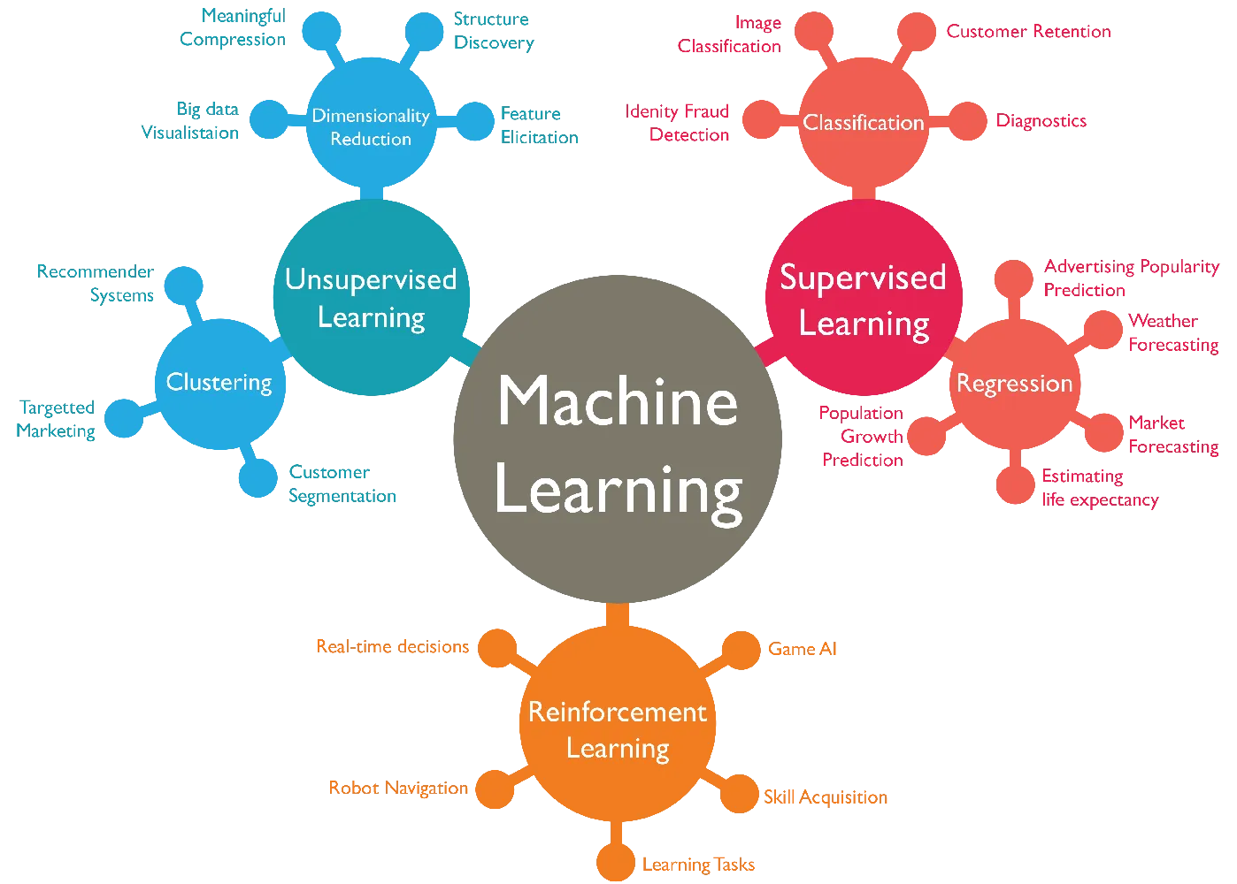
Motivation
State-of-the-art Methods in Insect Monitoring
Convolutional Neural Networks
Automate the processes of
Detection
Classification
Counting of insects from imagery
Significantly improving both efficiency and accuracy

Slide 7
TABLE OF CONTENTS
Motivation
Research Questions
Methodologies
Evaluation Metrics
Results
Insights

Slide 8

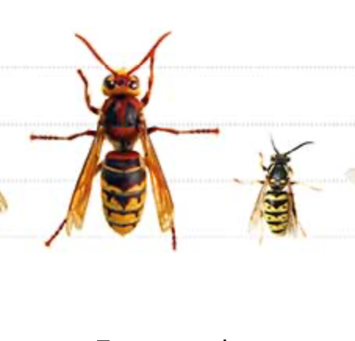
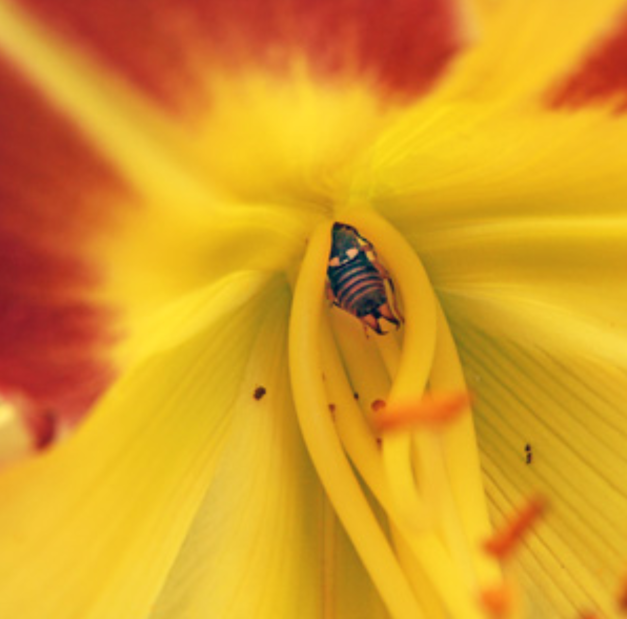
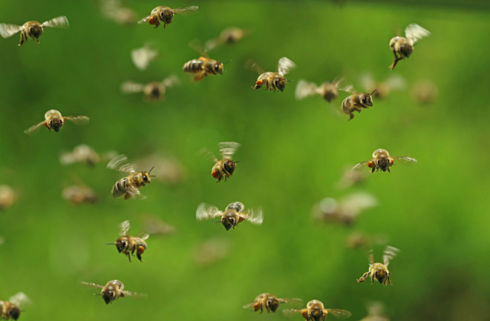
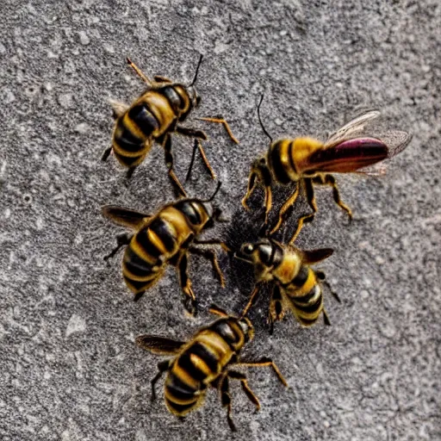
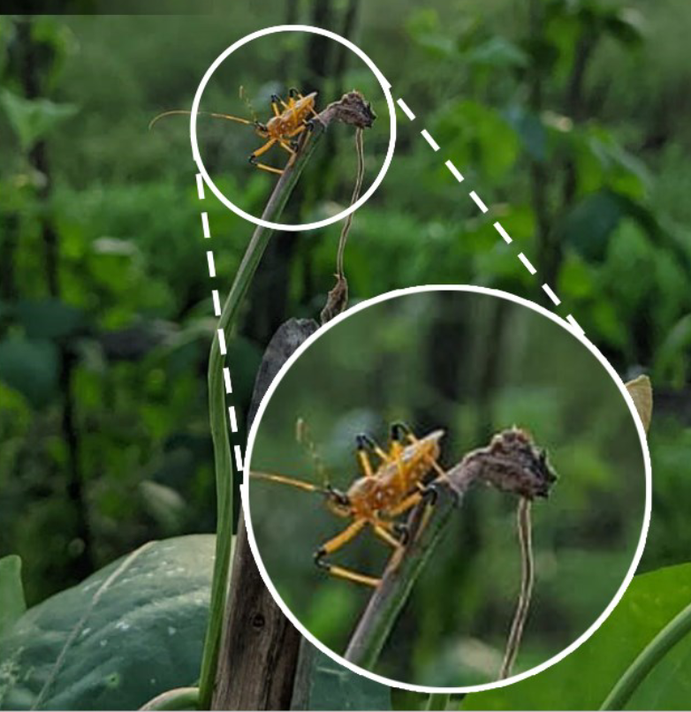
Research Questions
Precision and Robustness of CNN Models
Handling Environmental and Image Quality Challenges
CNN Performance for:
Multiple Insects in Images
Different Scales of Images
Different Sizes of Insects (Scale Sensitivity)
Partial Occlusion of Insects
Blurry Background or Significant Noise

Slide 9
TABLE OF CONTENTS
Motivation
Research Questions
Methodologies
Evaluation Metrics
Results
Insights

Slide 10
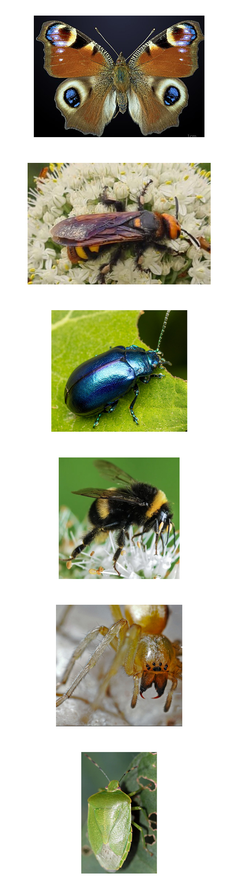
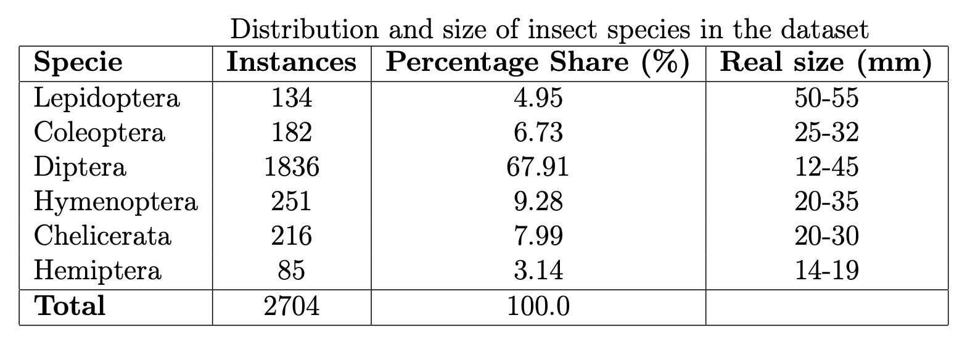
Methodology (Dataset)
Lepidoptera
Data Collection: Insect images were captured using camera traps at Austrian locations by the UNESCO CHAIR on Sustainable Management in the summer of 2022 at Fachhochschule Kärnten .
Data Annotation: Previously done by experts in the Labelbox environment.
Diptera
Coleoptera
Hymenoptera
Chelicerata
Hemiptera
Notes:
1. **Data Acquisition**: The insect detection dataset was collected using camera traps in three different locations in Austria, capturing images of insects visiting blooming plants in various environmental conditions, while facing challenges like camera overheating and autofocus issues.
2. **Camera Setup Challenges**: The Ricoh WG-70 cameras used for monitoring faced issues with overheating, inconsistent autofocus, and battery limitations, which impacted the quality and continuity of the captured images.
3. **Data Annotation**: Labelbox was used for efficiently annotating insect images, streamlining the classification process for developing the YOLOv8 model, which reduced the manual data collection efforts.

Slide 11




Methodology (Frameworks)
Software stack:
Python 3.11.8 is used as the programming environment
TensorFlow and Pytorch: These libraries are used for backend processing and loss functions
Hardware setup:
The models are trained on a system equipped with a Quadro P1000
GPU with 4096MiB of memory, utilizing CUDA 11.7 for acceleration

Slide 12
Methodology (Our approach)
Approach
What it is
Year Released
How it works
Strengths
YOLOv8
A model that detects objects very fast.
Jan 2023
Looks at the whole image once and finds objects in one go.
Super fast and good for real-time detection tasks.
Faster R-CNN
A model that’s great at finding objects with high accuracy.
2016
First looks for possible object areas, then checks them closely
Very accurate, especially for tough, detailed images.
RetinaNet
A model that balances speed and accuracy.
Oct 2019
Looks at the whole image once but focuses on hard-to-find objects.
Handles difficult-to-detect objects well.

Slide 13
TABLE OF CONTENTS
Motivation
Research Questions
Methodologies
Evaluation Metrics
Results
Insights

Slide 14
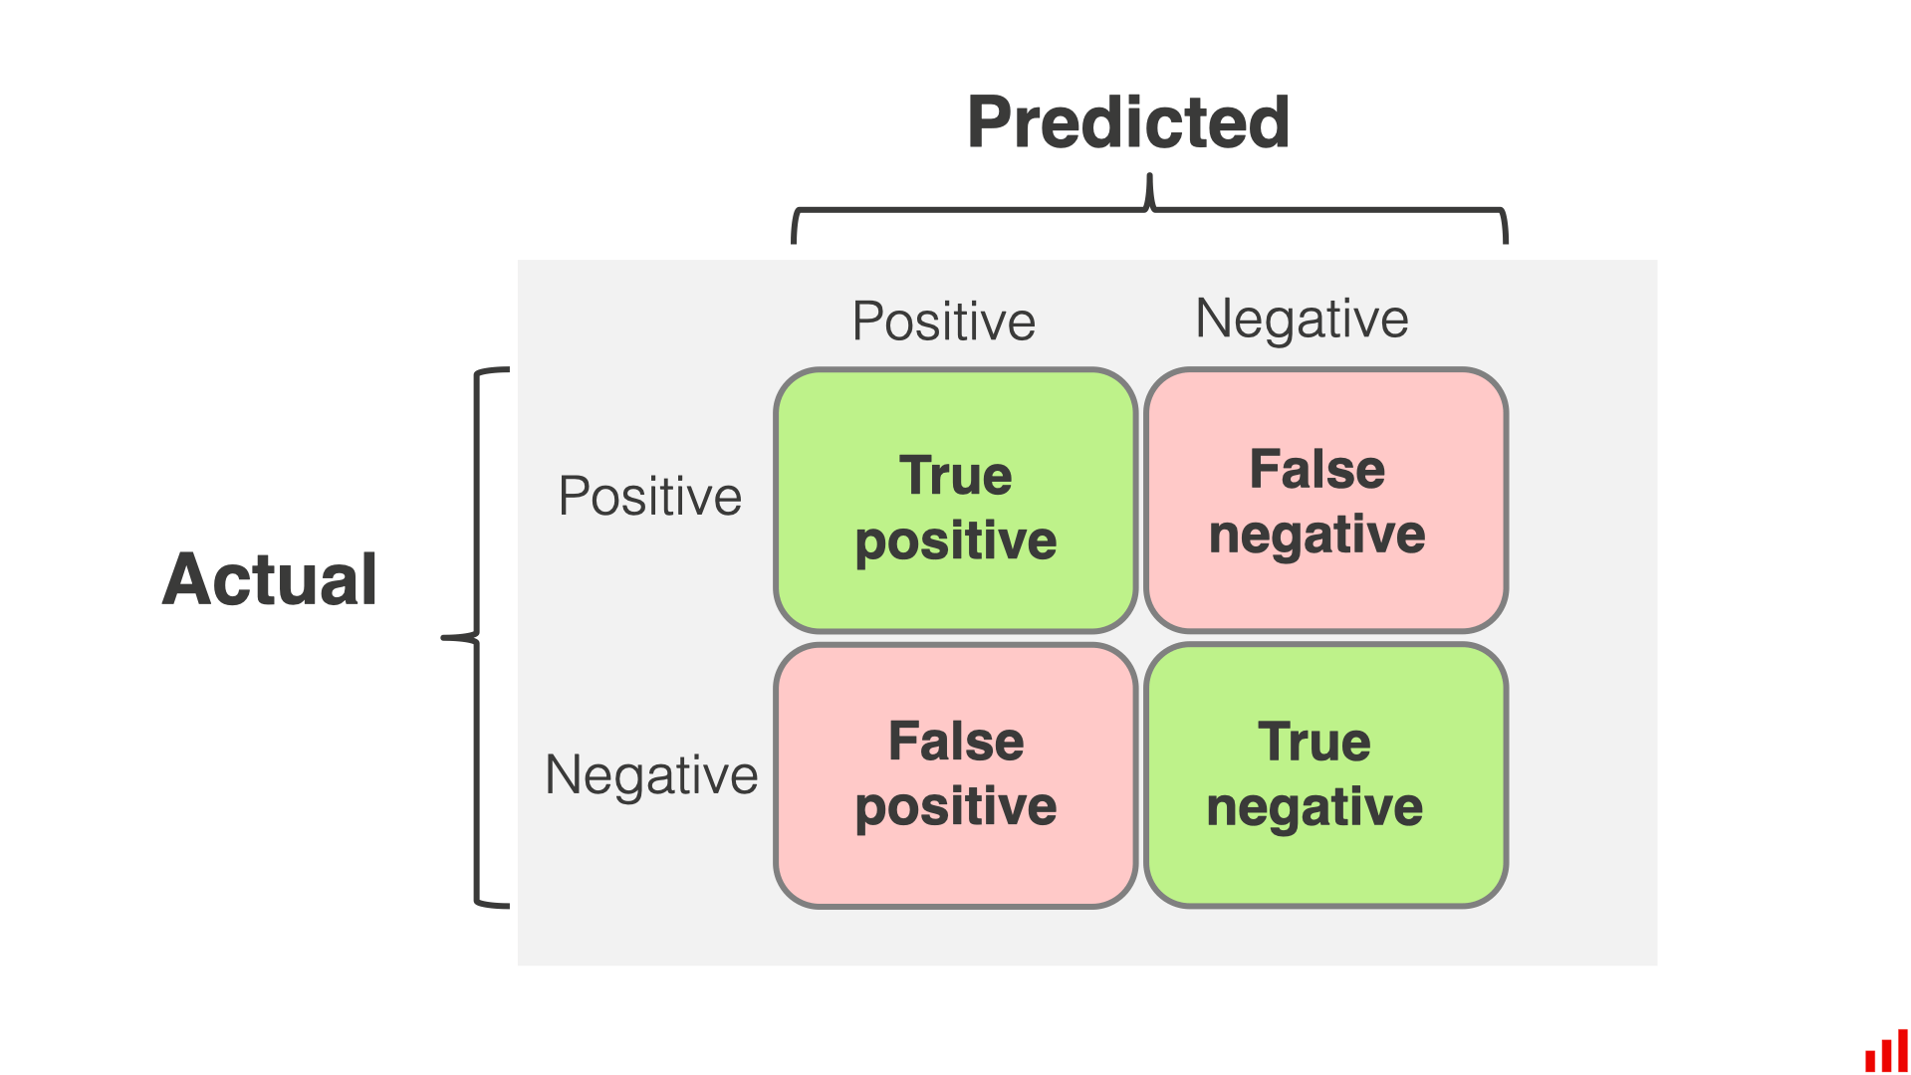
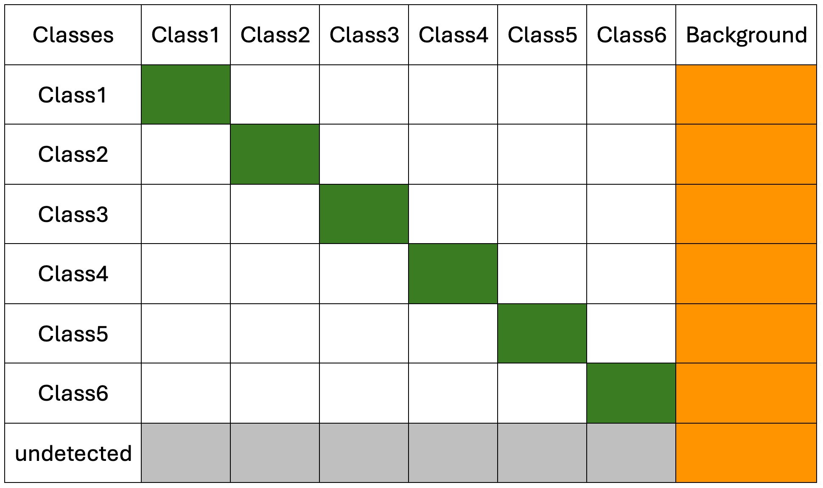
Evaluation Metrics (Confusion Matrix)
What is it:
A table that breaks down predictions into true positives, false positives, true negatives, and false negatives.
How it helps the research:
The improved confusion matrix for multiclass classification Helps to understand where the model is making mistakes, like misclassifying background elements as insects and with other classes.

Slide 15
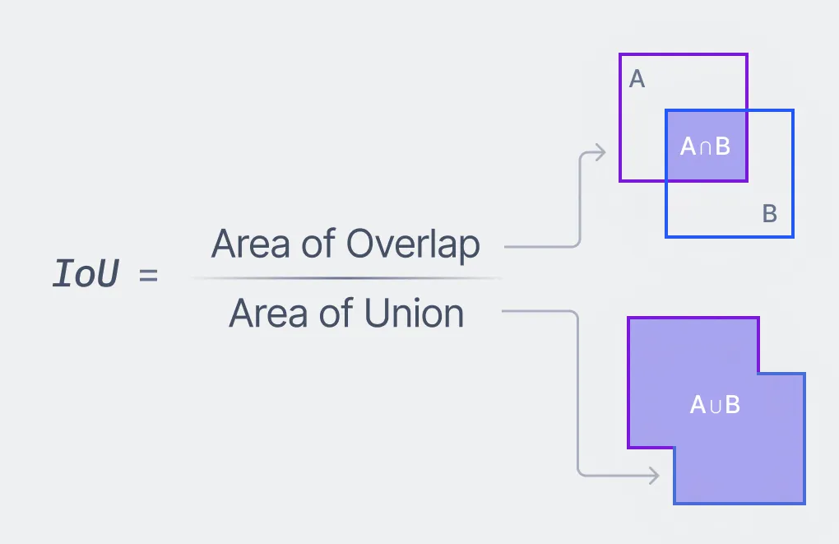
Evaluation Metrics (mAP(@50-95) & F1 Score)
What is mAP:
A score that shows how accurate the model is in detecting objects (insects) at different levels of overlap(50% to 95%)
What is F1 Score:
The F1 Score helps to understand how well the model balances finding as many insects as possible without mistakenly identifying other things as insects.
For these two metrics, The weighted mAP and weighted F1 score are used to consider the class imbalance
to have less biased results regarding poor distribution.

Slide 16
TABLE OF CONTENTS
Motivation
Research Questions
Methodologies
Evaluation Metrics
Results
Insights

Slide 17
Results (Insect-level detection on the validation set- Best configurations for each selected architecture)
Detection performance metrics on the validation set for insect-level
Model | mAP@50-95 | F1 Score
YOLOv8 | 0.93 | 0.99
Faster-RCNN | 0.87 | 0.99
RetinaNet | 0.84 | 0.99
Percentage count of generated labels
for each of the selected CNNs

Slide 18
Results (Species-level detection on validation set- Best configurations for each selected architecture)
Detection performance metrics on the validation set for species-level
Model | Weighted mAP@50-95 | Overal mAP | Weighted F1 Score
YOLO | 0.71 | 0.84 | 0.74
Faster-RCNN | 0.33 | 0.39 | 0.54
RetinaNet | 0.47 | 0.37 | 0.60
Percentage count of generated labels
for each of the selected CNNs

Slide 19
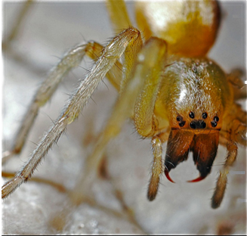
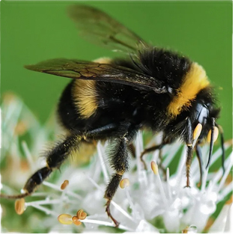
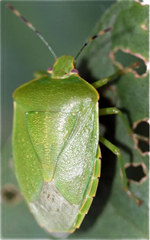
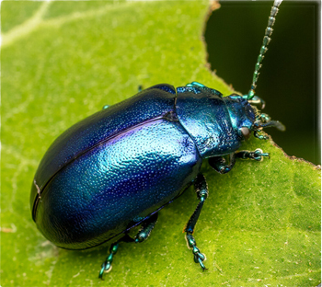
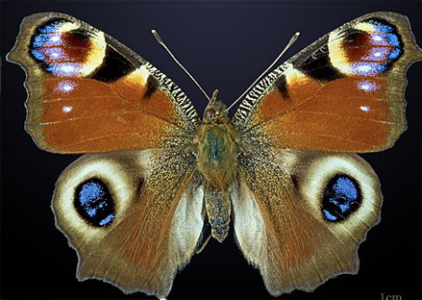
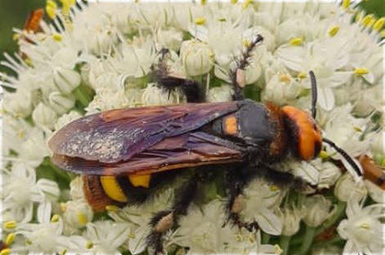
Results (Species-level detection on validation set- Best configurations for each selected architecture)
Detection performance metrics for each species
Model | Chelicerata mAP | Coleoptera mAP | Diptera mAP | Hemiptera mAP | Hymenoptera mAP | Lepidoptera mAP | Overall mAP
YOLO | 0.93 | 0.86 | 0.91 | 0.65 | 0.82 | 0.86 | 0.84
Faster-RCNN | 0.52 | 0.33 | 0.80 | 0.24 | 0.39 | 0.30 | 0.39
RetinaNet | 0.65 | 0.57 | 0.85 | 0.21 | 0.46 | 0.68 | 0.58

Slide 20
Results (Insect-level detection on original scales of validation as test set - Best configurations)
Detection performance metrics on the test set for insect-level
Model | mAP@50-95 | F1 Score
YOLOv8 | 0.36 | 0.51
Faster-RCNN | 0.10 | 0.18
RetinaNet | 0.11 | 0.52
Percentage count of generated labels
by each of the selected CNNs

Slide 21
Results (Species-level Detection on original scales of validation as test set – Best configurations)
Detection performance metrics on the test set for species-level
Model | Weighted mAP@50-95 | Overal mAP | Weighted F1 Score
YOLO | 0.34 | 0.38 | 0.37
Faster-RCNN | 0.13 | 0.14 | 0.25
RetinaNet | 0.13 | 0.13 | 0.31
Percentage count of generated labels
by each of the selected CNNs

Slide 22
Results (Species-level Detection on original scales of validation as test set – Best Configurations)
Detection performance metrics for each species
Model | Chelicerata mAP | Coleoptera mAP | Diptera mAP | Hemiptera mAP | Hymenoptera mAP | Lepidoptera mAP | Overall mAP
YOLO | 0.51 | 0.45 | 0.39 | 0.32 | 0.38 | 0.25 | 0.37
Faster-RCNN | 0.13 | 0.20 | 0.10 | 0.00 | 0.19 | 0.21 | 0.14
RetinaNet | 0.09 | 0.18 | 0.08 | 0.04 | 0.06 | 0.24 | 0.11

Slide 23
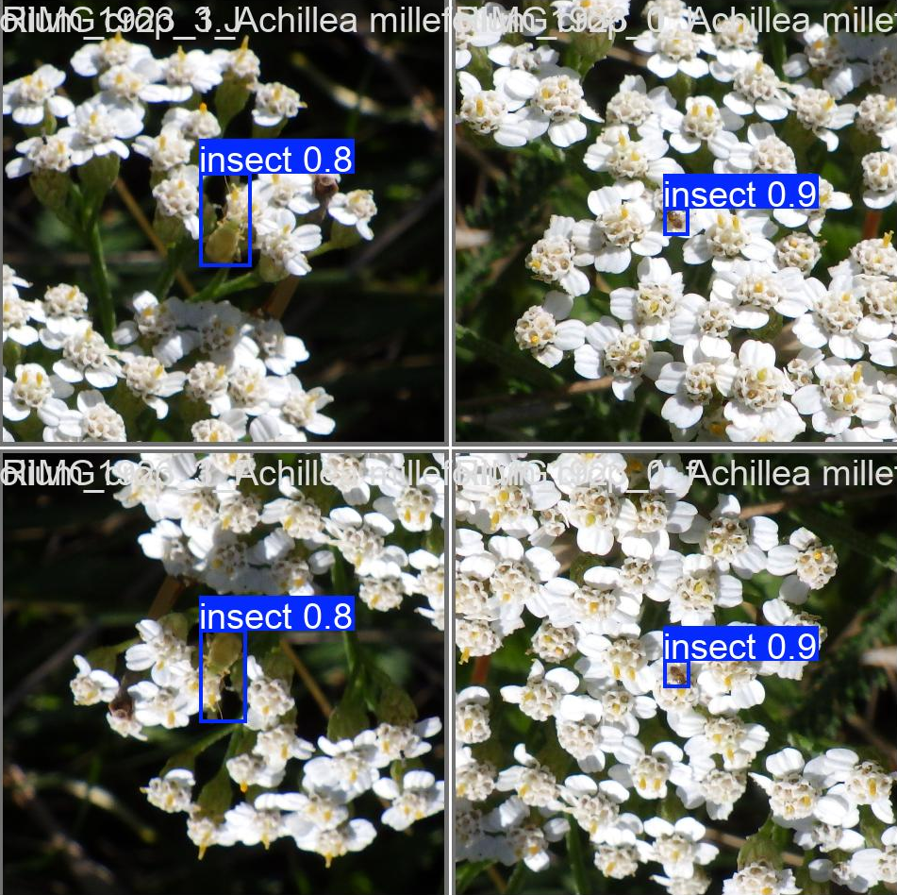
Results (Detection under differnet images challenges for YOLOv8 as best performing model)
Yolov8 performance metrics under different Scenario for insect-level
Scenarios | Weighted mAP@50-95 | Weighted F1 Score
Clear_Images | 0.80 | 0.92
Blurry_Images | 0.76 | 0.94
Partialy_Hidden_Insect | 0.71 | 0.90
Oblique_View | 0.77 | 0.92
Nadir_View | 0.79 | 0.93
Original_Images | 0.61 | 0.93
YOLOv8 detection visualization for Nadir_View

Slide 24
Results (Detection under differnet images challenges for YOLOv8 as best performing model)
Yolov8 performance metrics under different Scenario for species_level
Scenarios | Chelicerata mAP | Coleoptera mAP | Diptera mAP | Hemiptera mAP | Hymenoptera mAP | Lepidoptera mAP | Overall mAP
Clear_Images | 0.83 | 0.71 | 0.76 | 0.36 | 0.75 | 0.17 | 0.60
Blurry_Images | 0.76 | 0.57 | 0.73 | 0.65 | 0.77 | 0.25 | 0.62
Partialy_Hidden_Insect | 0.71 | 0.77 | 0.68 | 0.69 | 0.67 | 0.27 | 0.63
Oblique_View | 0.80 | 0.69 | 0.75 | 0.60 | 0.70 | 0.20 | 0.62
Nadir_View | 0.68 | 0.63 | 0.76 | 0.35 | 0.76 | 0.75 | 0.65
Original_Images | 0.59 | 0.55 | 0.60 | 0.51 | 0.43 | 0.52 | 0.53

Slide 25
TABLE OF CONTENTS
Motivation
Research Questions
Methodologies
Evaluation Metrics
Results
Insights

Slide 26
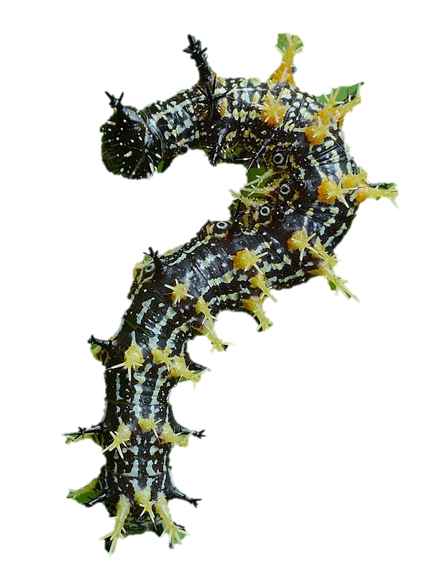
Insights
Key Insight
Overall Performance
Handling Environmental Challenges
Species Imbalance Impact
Computational Efficiency
Best Use Case
YOLOv8
Best Performing.
Balanced performance
Most resilient to species imbalance but challenges remain.
Superior Inference time
Ideal for research and conservation where accuracy is key.
Faster R-CNN
Balanced performance Not suggested on unintroduced scales
Not Suggested
Struggles with rare species detection.
Balanced in training and inference time
Not for this research
Retina Net
Almost the same performance as Faster_Rcnn
Not Suggested
Struggles with rare species detection.
Balanced in training and inference time
Not for this research
Questions

